Slide 1
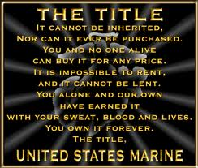
CEREMONY SEQUENCE OF EVENTS
Regiment’s Own Video
Invocation given by Chaplain Earls
National Anthem
Opening Remarks by Battalion
Commander LtCol Fitzgerald
Letter from the Commandant
Certificate Presentation
Anchors Away and Marines’ Hymn
**Refreshments will be served next door in the Social Hall
Immediately following the ceremony
NAMES
CPL JONATHAN ALANIZ CPL ISAAC A. AMEZCUA
CPL NAOMI G. ARELLANOBLACKHAWK
CPL KEVIN E. ARRANT CPL SARAH M. ARROYO
CPL LALYDIA L. BELONE
GYSGT SHAUNTAVIA T. BLACKMON
LCPL SYDNEY J. BRINK CPL HAWKINS CAMPBELL
CPL CHANCE, AUTUM S. LCPL JAVIER CHAVEZ
CPL CHAD L. DALLAS CPL JOHNNIE DAVIS III
CPL DEXTERJOSE A. DIN SGT JOHN K. DOKU JR
CPL DANZEL L. FELLOWS SSGT MARK A. FIGUEROA
CPL SAMANTHA M. FISK SGT JUSTIN M. FORGETTE
CPL EMMA J. GAMBINI CPL REUBEN A. GARCIA
CPL NAOMI J. GIRON CPL CRISOFORO GOMEZ JR
SGT SEAN E. GREENLEE CPL CHRISTOPHE HAYNES
CPL VICTOR HERNANDEZ CPL JOSEPHINE HINOJOS
CPL WILLIAM F.HOLGUIN CPL KOLTON B.HOULE
CPL DARNELL JEFFERSON CPL MERLE W. JOSLIN III
LCPL LAUREN N. MAGEE CPL ALICIA N. MAJOR
CPL ANDREW MELGAR SGT ALEXANDER V. MIDDLETON
SGT MARLENE A. PEREZ CPL EDGAR E. REYES
CPL JUAN RODRIGUEZ III CPL DIONY J. ROJAS
LCPL ANTHONY ROMAN CPL ALINA SANCHEZ
CPL ANGELICA SHANKMAN CPL MICHAEL R. SMERK
CPL JAMES T. SMITH CPL ANDREW E. STEVENS
CPL CARLOS S. TRUJILLO CPL STEVE A. VICTORINO
CPL MARQUIS WHITESIDE CPL MELINDA WHITESIDE
CPL STEVEN J. WILSON
2
3

Slide 2
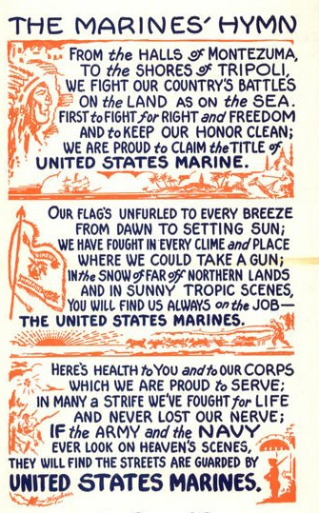
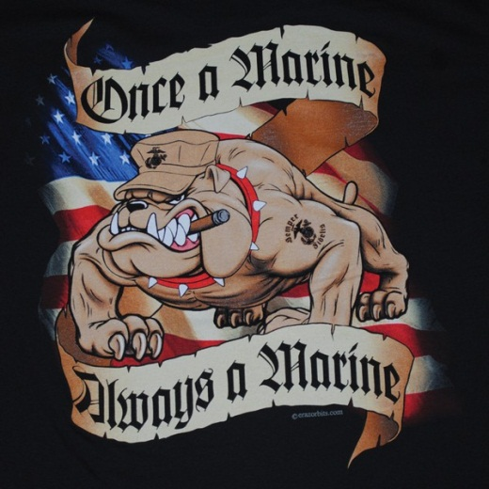
May 23, 2013
1330
ALWAYS
FAITHFUL
CEREMONY
4
1

